Slide 1
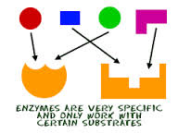
Enzymes
Chapter 19

Slide 2
Enzymes and Pac Man (4:50)

Slide 3
Enzymes
Objectives
Vocabulary
Explain the function of enzymes as a catalysts in chemical reactions.
Describe the relationship between an enzyme and a substrate.
Compare the functions and activities of enzymes and coenzymes.
Explain how enzymes are used in digestion.
Describe how food scientists manage enzyme activity.
Identify influences on enzyme activity.
Explain how enzyme reactions are involved in food preparation.
Activation energy
Active site
Blanch
Catalyst
Coenzymes
Enzymatic browning
Papain
substrate

Slide 4
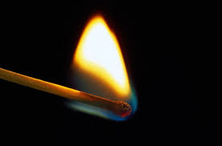
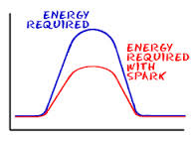
Enzymes Influence Reactions
Activation Energy – the energy that supplies the force needed for a reaction.
Catalyst – substance (the enzyme) that speeds up the rate of a reaction without being permanently changed or used up itself.

Slide 5
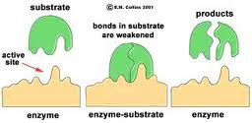
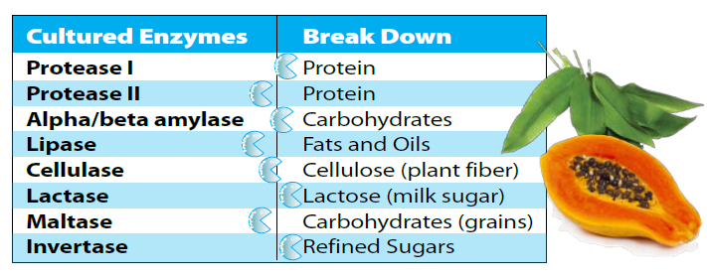
Enzymes Influence Reactions
Substrate – the substance in which the enzyme works

Slide 6
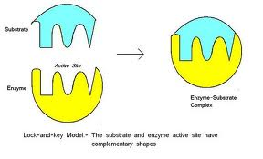
Enzymes Influence Reactions
Active Site – the area of an enzyme that fits into the shape of a substrate.
Coenzymes – partner of the enzyme, heat-stable, organic molecules that must be loosely associated with an enzyme for the enzyme to function.

Slide 7
Enzymes- a fun introduction (4:46)

Slide 8
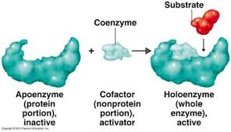
Enzymes Influence Reactions
Influencing the active site – Coenzymes often alter the shape of the enzyme’s active site so the enzyme “fits” the substrate better and the reaction can take place
Serving as transfer agents – Coenzymes act as transfer agents for atoms, electrons, or groups of atoms during a reaction

Slide 9
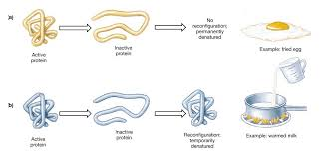
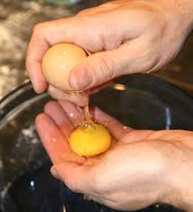
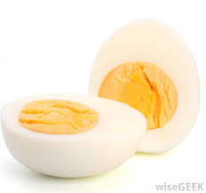
Enzymes in Food Science
Scientists
Need to learn which enzymes control particular reactions, than they can look for ways to control those reactions
Learn how to denature or inactivate enzymes

Slide 10
Enzymes and Denaturing (2:15)

Slide 11
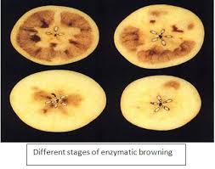
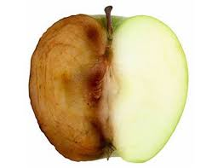
Enzymes in Food Science
Learn how to slow down an enzymatic reaction
Enzymatic Browning

Slide 12
Apple Oxidation & The Scientific Method: A fun, at-home science experiment

Slide 13
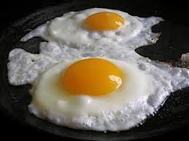
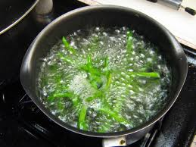
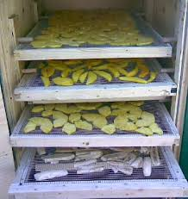
What Affects Enzyme Activity?
Temperature
Blanching
pH
Water

Slide 14
Explain factors affecting enzyme activity (2:48)

